Slide 1

Fake News Detection System
Group 9
Anudeep S.Nerwal – W0785695
Pushwinderjit S.Mandahar – W0780371
Manjot Gill – W0770110

Slide 2

Table of Content
Effects of fake news
Problem Identification
Research Questions
Dataset and its sources
Dataset Insights
Data Assessment
Data Pre-Processing
Visualizations
Conclusions
Future Work
Web Application Demonstration

Slide 3
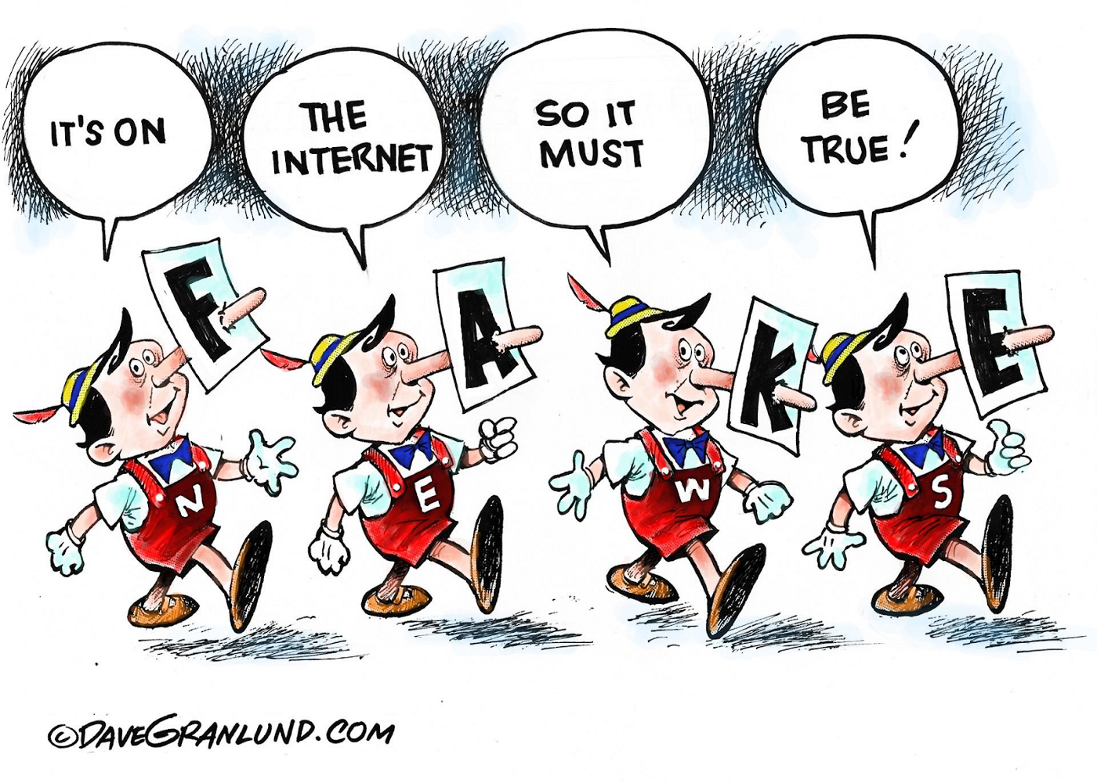
Motivation behind this study

Slide 4
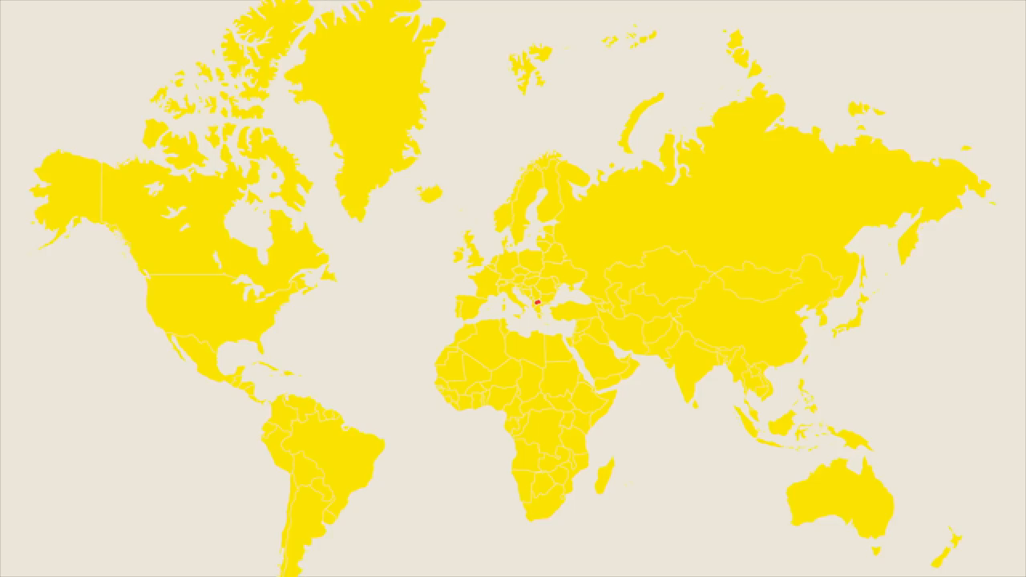

Slide 5
Problem Identification
There are growing problems in the domain of recognizing the difference between fake and authentic news on a variety of mediums.
As we know the spread of fake news over social media is very high and almost all generations are highly active on these platform.
There is a serious impact that affects a person’s personal & professional life entirely, all because of some fake news articles.

Slide 6
Research Objectives
The major issue identified for the chosen project is to develop a trained model that can identify which news articles are fake or vice versa.
Due to fake news the common people always suffer either in riots, motivated political rallies, violence or many more disasters. There are little resources where an individual can verify the news.

Slide 7

Data Insights
There are multiple datasets that were imported:
Kaggle Dataset
ISOT Fake news Dataset
Both datasets consists of majorly World News, World politics, Government, North American News and other genre of news.

Slide 8

Assessment of Data
Kaggle’s Dataset : 20800 rows & 5 columns
ISOT Fake news: 44898 rows & 4 columns
The final combined & trained data: final_merged_dataframe_kaggle_fakeNews.csv
Total Raw Variables in Dataset’s:
10413 Fake Articles (Kaggle Data)
10397 Real Articles (Kaggle Data)
23481 Fake Articles (ISOT Dataset)
21417 Real Articles (ISOT Dataset)

Slide 9
Assessment of Data
The Trained & Prepared attributes in this dataset:
1. Id: unique id for a news article
2. Title: the title of a news article
3. Text: the text of the actual news article
4. Label: a label that marks the article as potentially unreliable and reliable
5. Datatype: Identification of dataset over Kaggle and ISOT Dataset
Count: 65659 rows and 5 Columns
Cont. Assessment of data

Slide 10
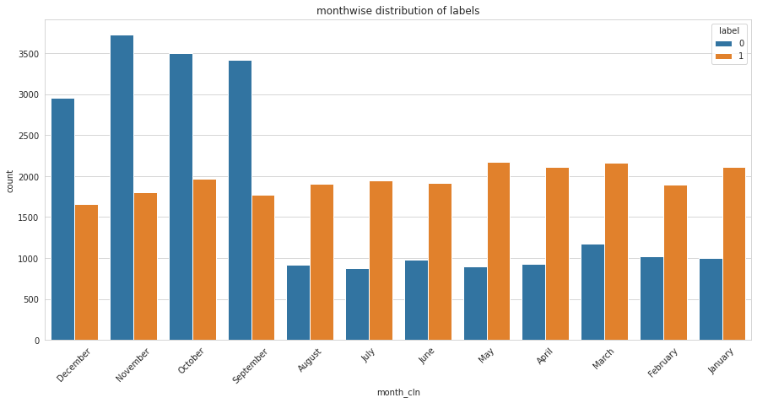
Graphical Representation of Data
ISOT Dataset distribution by monthly basis collected for three years

Slide 11
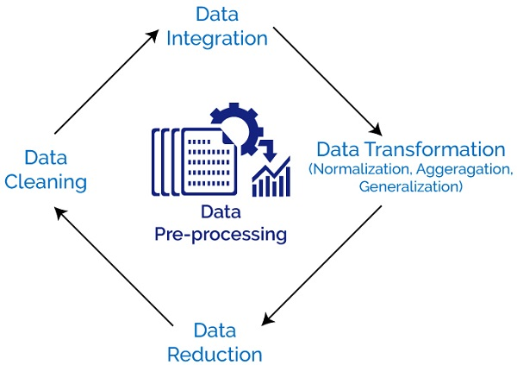
Data Preprocessing Method
All the pre-processing steps have been executed by using these techniques:
1. NLTK
2. Wordnet
3.Bag of Words
4. Stop words
5.Tokenization
6. OMW
Apart from that, we used Contractions to filter all the unused text from the string of data so that model can understand the variable.

Slide 12
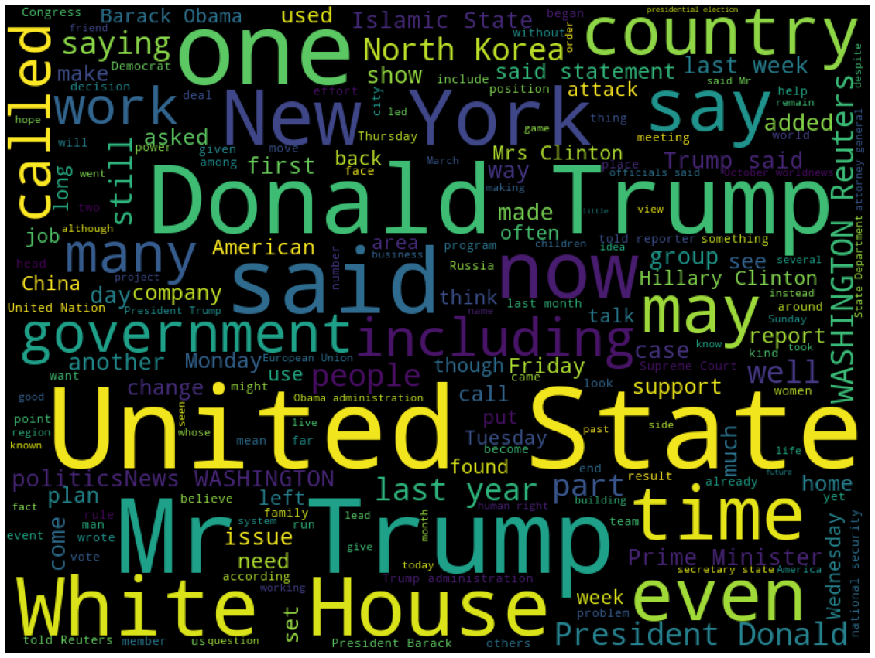
Exploratory Data Analysis Visualization
The following graph shows the word cloud of real news articles

Slide 13
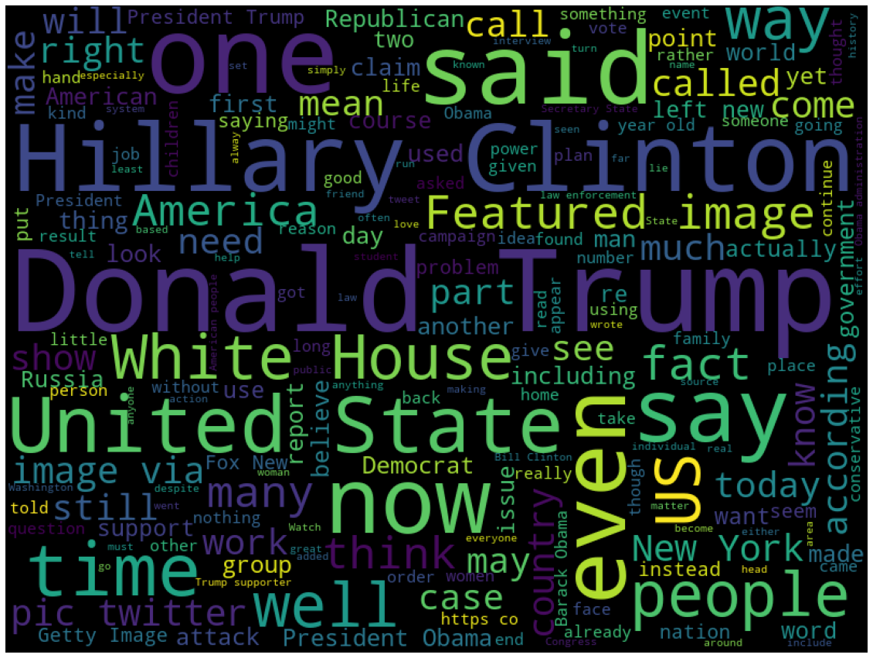
Exploratory Data Analysis Visualization
The following graph shows the word cloud of fake news articles

Slide 14
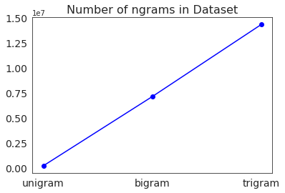
Count Vectorization
We tested our data on different count vectorizers within Bag of Words Technique.
Unigram: 223065
Bi-Gram: 7129330
Tri-gram: 14318344
According to line graph’s result we trained the data taking Tri-gram, that have the higher values among all ngrams.

Slide 15
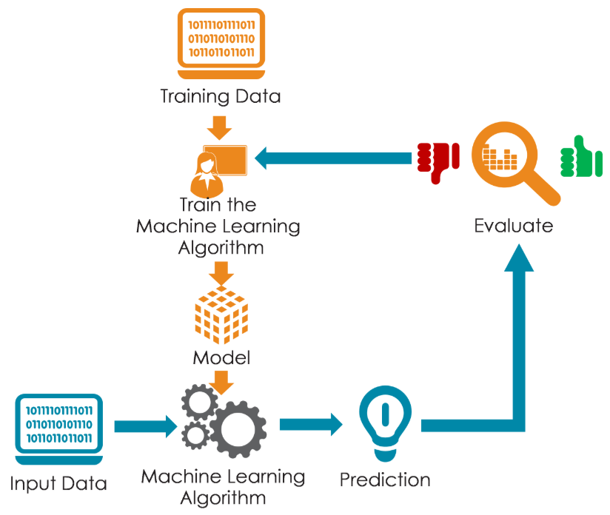
Analysis and Method of Modelling
We got almost 0.9680 % accuracy on the test data with “Logistics Regression” Model, Apart from that we got “0.7687%” accuracy using LSTM.
Apart from this we used a vectorization technique to transform.
1. Bag of words
2. TF-IDF & Vectorization
3. Simple Logistics Regression
After that we saved the model and integrate with Streamit web application to demonstrate the visualizations of the results.

Slide 16
Analysis and Method of Modelling
Trained Data | 70%
Train score with bow features | 0.9999782424229238
Train score with Tf-idf features | 0.9999782424229238
Test Data | 30%
Test Score with Bow Features | 0.9608082038785664
Test score with Tf-idf features: | 0.9623312011371713
Cont. Analysis & Method of Modelling

Slide 17

Conclusions
Our model is enough trained to identify U.S. political and World politics news.
We used 70% of the data to train the model and the remaining 30% to test the model, and our project ended with 96 percent accuracy. We can say it is the best model to classify fake news.

Slide 18

Future work
Anyone can import newer dataset and the model will be trained with newer dataset.
The more model would be trained the more its accuracy will be precise to the result.
The more data, model trained with it will provide better & accurate results.

Slide 19
References
ISOT_Fake_News_Dataset_ReadMe.pdf (uvic.ca)
Fake News Generator: Who starts viral misinformation? - BBC News – YouTube
How false news can spread - Noah Tavlin – YouTube
Fake News | Kaggle
Stemming and Lemmatization: NLP Tutorial For Beginners - 10 – YouTube
FakeNewsDetection/FakeBuster: Fake News Detection with Machine Learning (github.com)

Slide 20
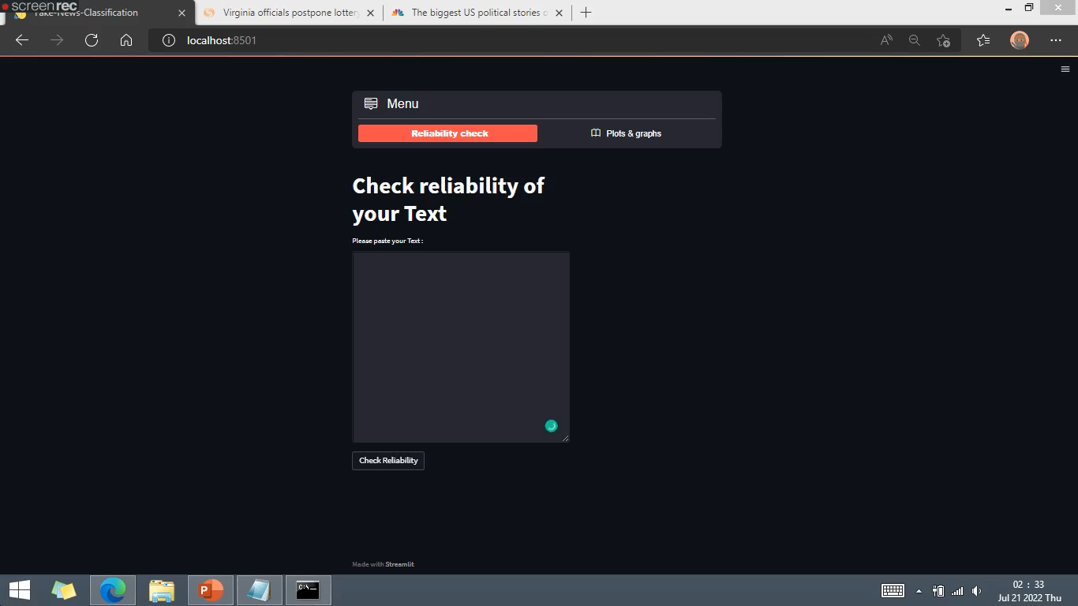
Web Application Demonstration

Slide 21

Data’s all, folks! Thank You!

